Slide 1

CSE 322 – Software Engineering
Final Project

Slide 2
PRESENTED BY
Name | ID
Hassan Essam Hashem | 120210068
Anas Osama Ali Dorgham | 120210156
Omar Eslam Abdelhamid | 120210190
PRESENTED TO
Prof. Ehab Elshazly

Slide 3

UNIVERSITY MANAGEMENT SYSTEM
I. Introduction
II. Requirements
III. Scrum Sprints
IV. UML Diagrams

Slide 4
Introduction
The University Management System is a software solution designed to provide an interface to streamline and manage key academic and administrative processes within a university environment.

Slide 5
Introduction
The University Management System is a software solution designed to provide an interface to streamline and manage key academic and administrative processes within a university environment.
Actors
Administrators
Students
Instructors

Slide 6
II. Requirements
II.I Functional Requirements
• Student registration and enrollment management.
• Course creation, scheduling, and management.
• Faculty profile management and course assignment.
• Grade recording, calculation, and reporting.
• Academic advising and degree planning support.

Slide 7
II. Requirements
II.II Non-Functional Requirements
• Usability: The system should have an intuitive and user-friendly interface.
• Security: The system must ensure data protection.
• Performance: The system should provide fast response times.
• Scalability: The system should be able to handle increased user load and data volume as the university grows.

Slide 8
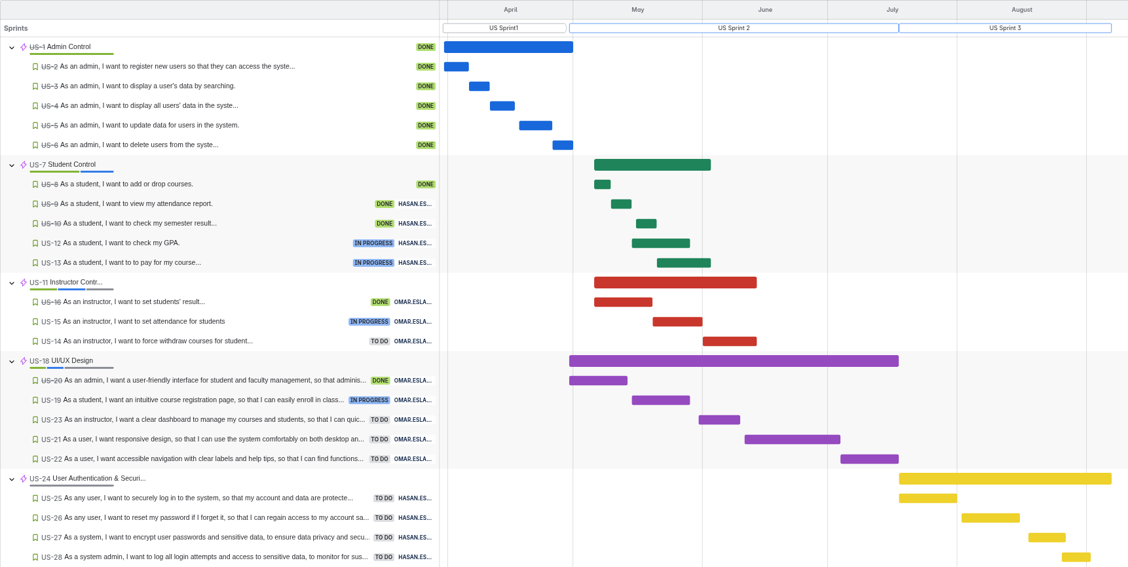
III. Scrum Sprints

Slide 9
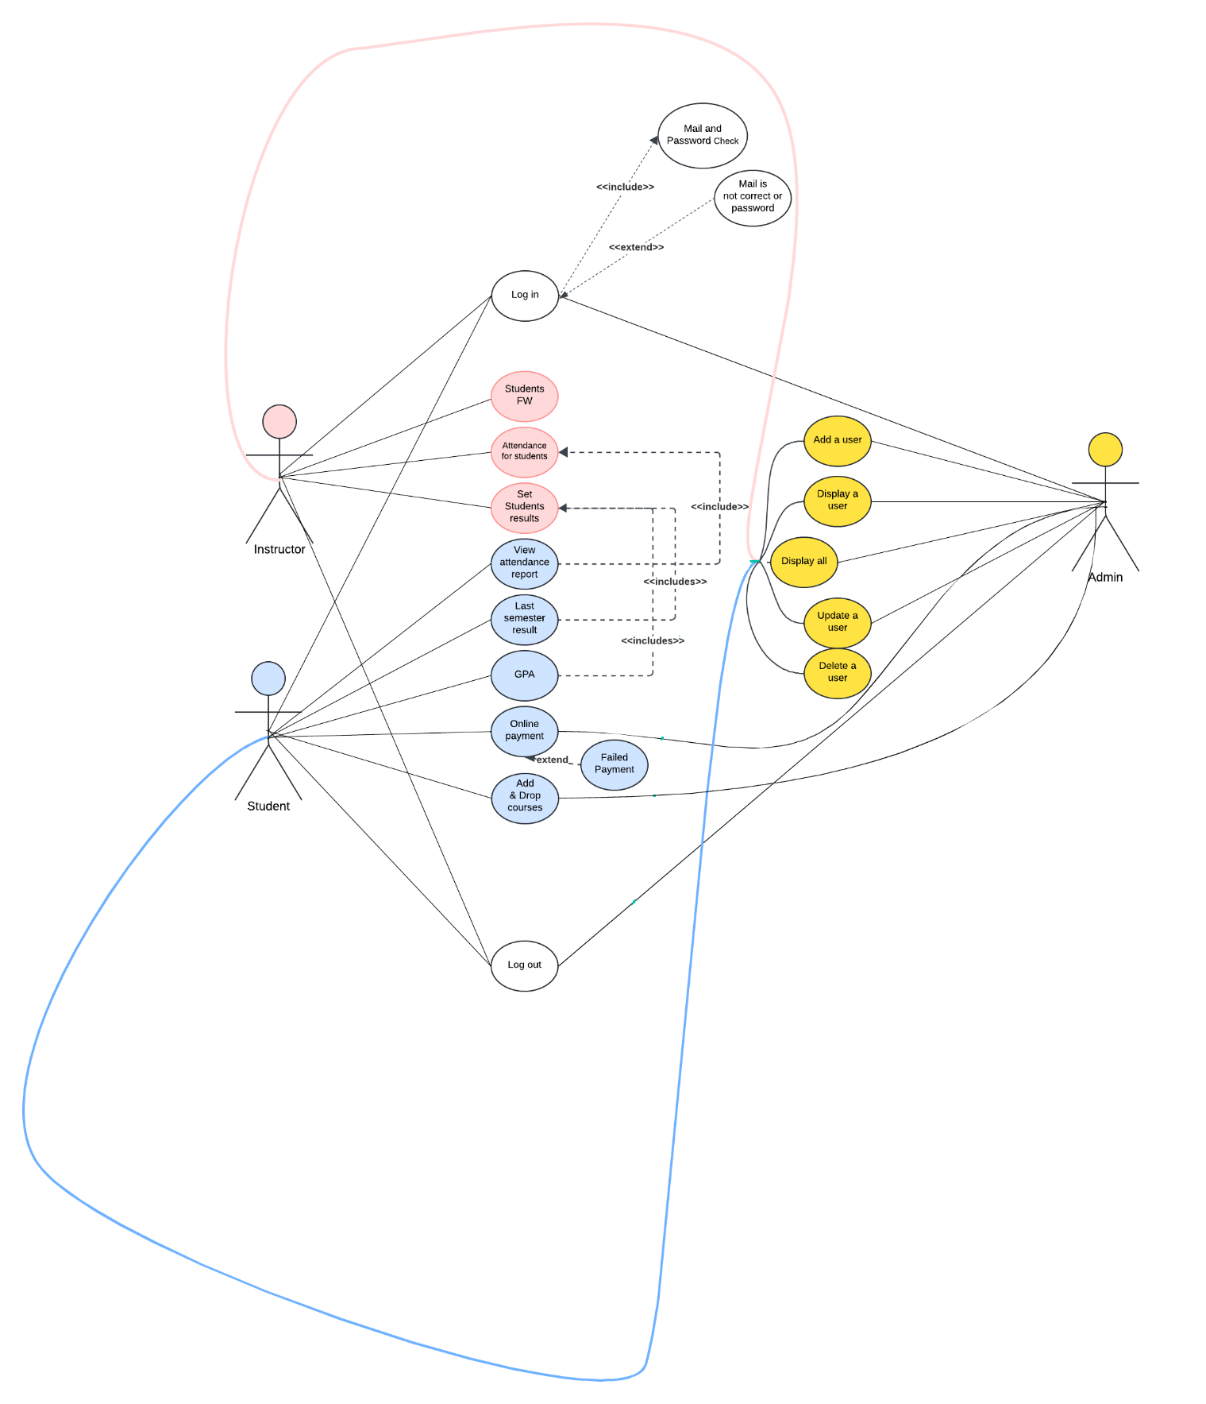
IV. UML Diagrams
IV.I Use Case

Slide 10
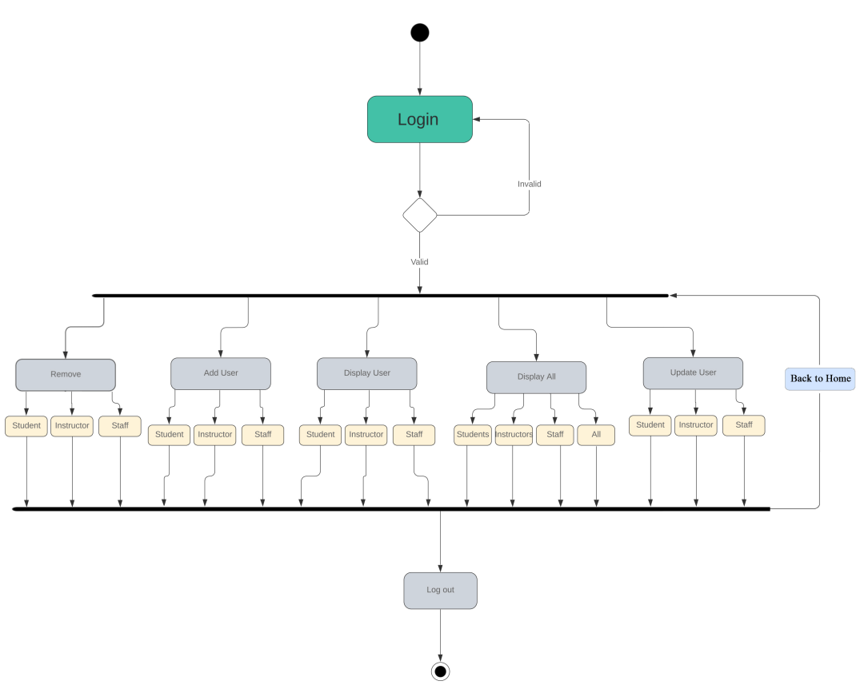
IV. UML Diagrams
IV.II Activity Diagrams
Admin

Slide 11
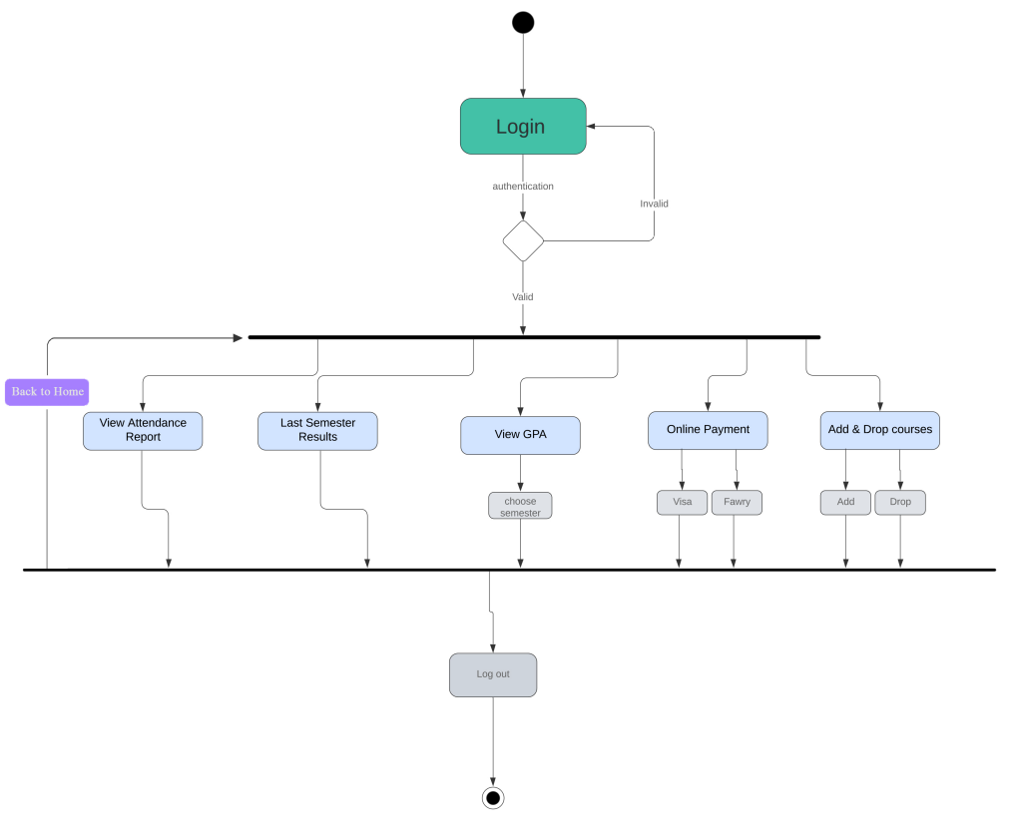
III. UML Diagrams
IV.II Activity Diagrams
Student

Slide 12
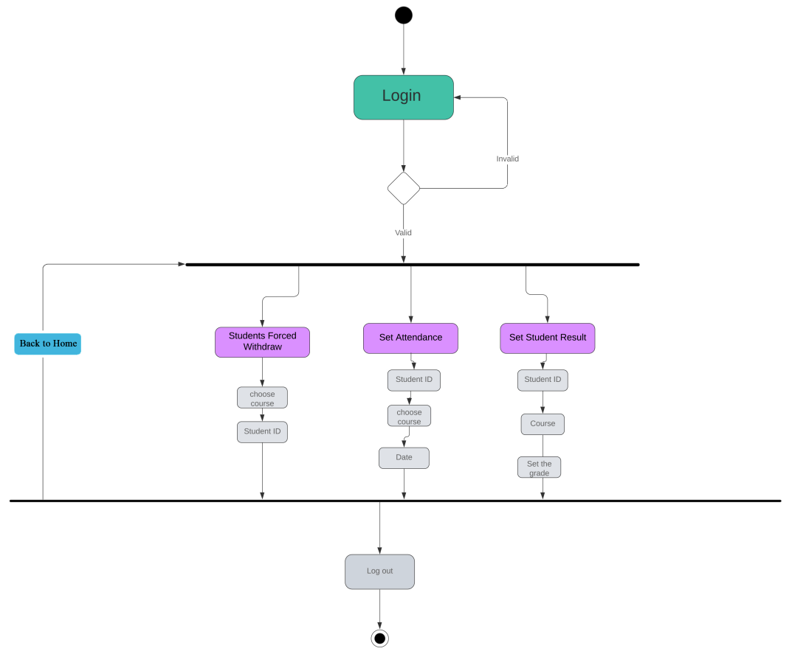
III. UML Diagrams
IV.II Activity Diagrams
Instructor

Slide 13
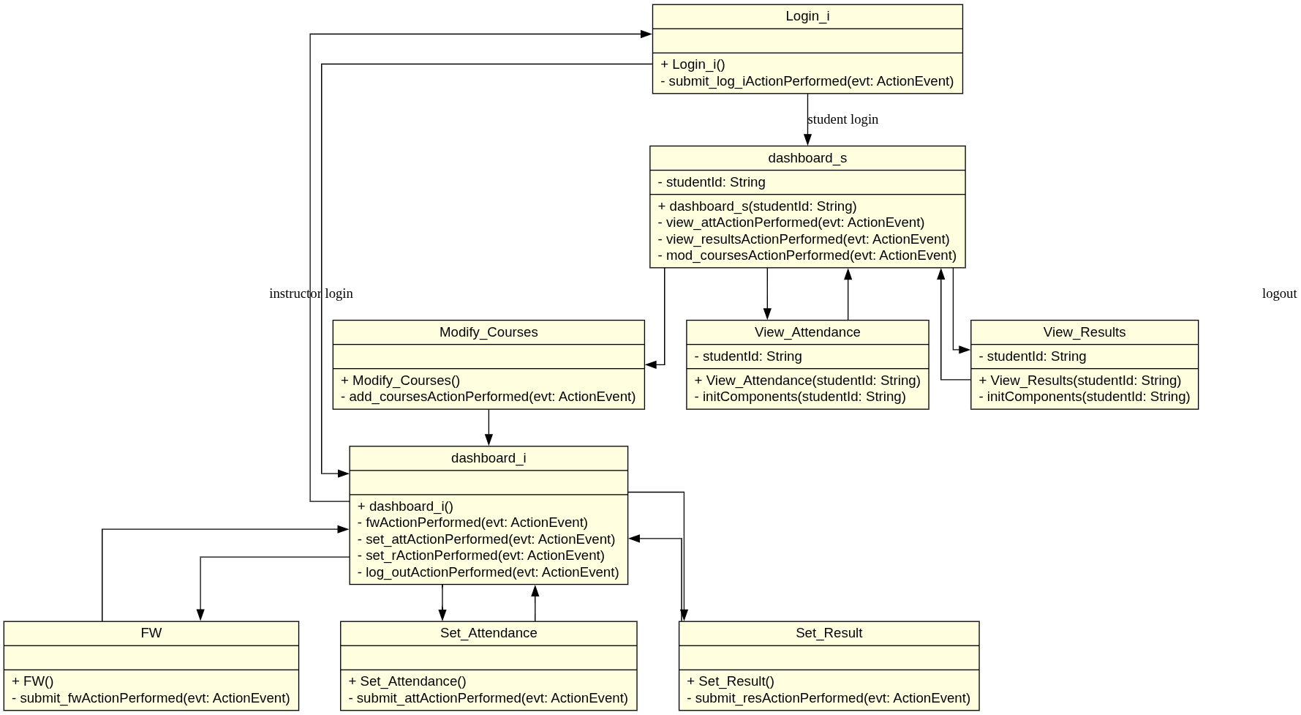
III. UML Diagrams
IV.III Class Diagram

Slide 14
Thank you for listening!

